Slide 1
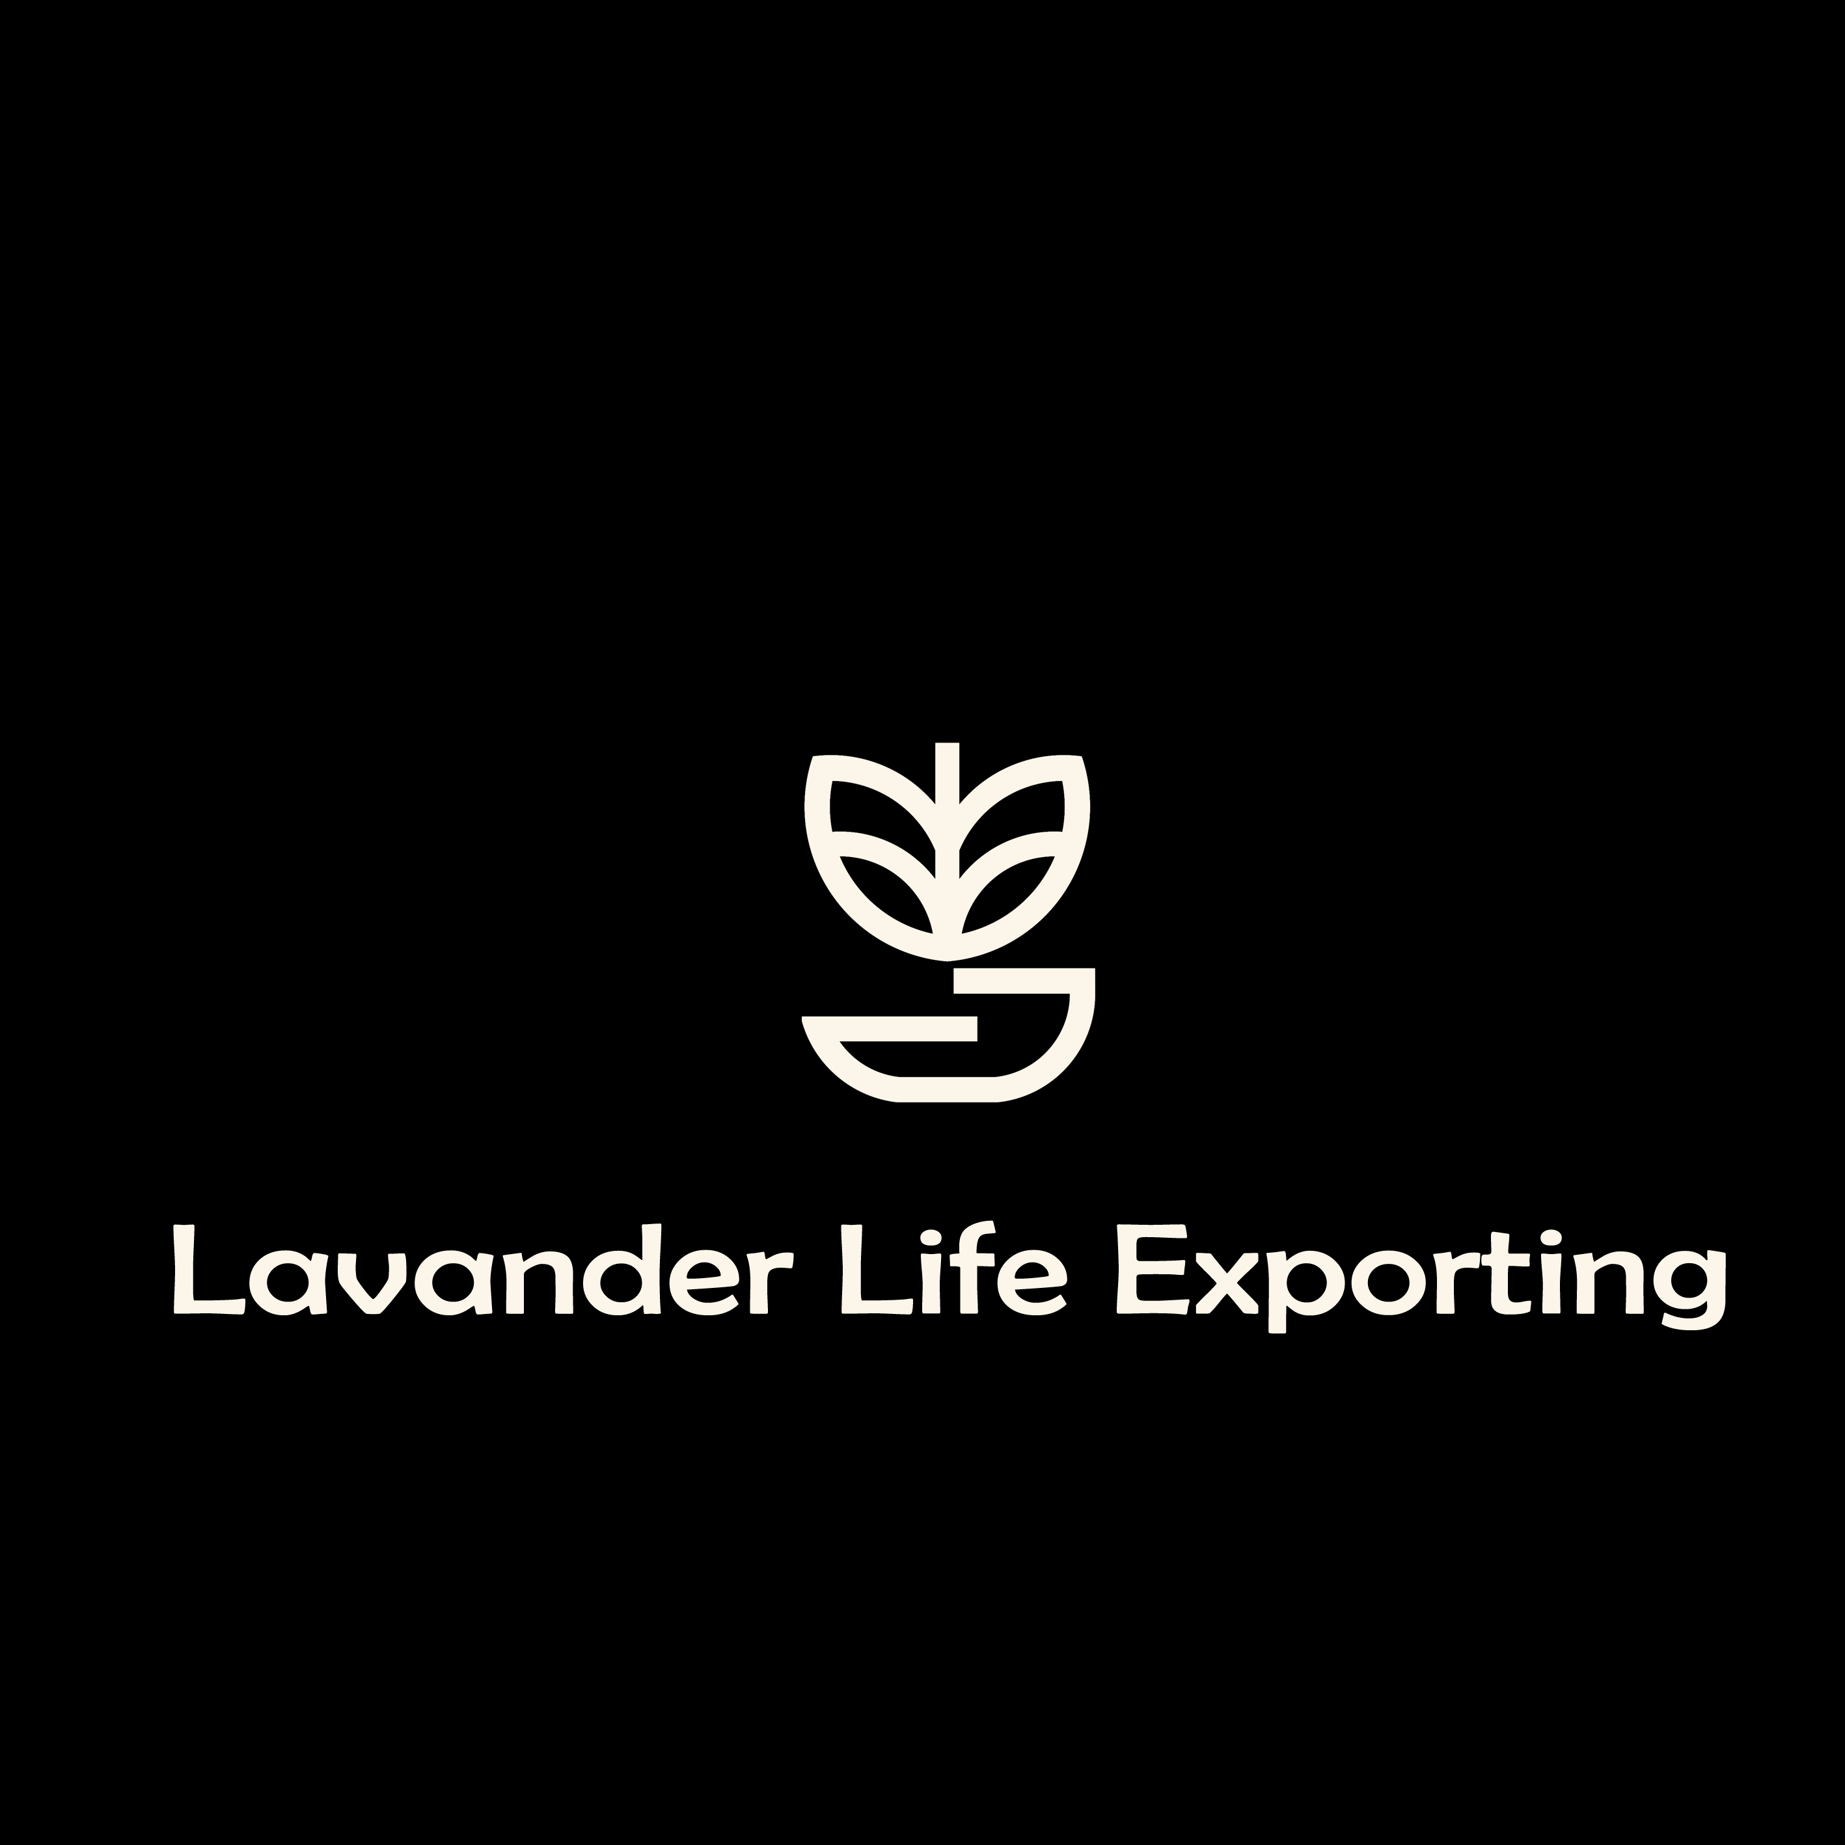

Pitch deck
“ Explore, Develop, Innovate "

Slide 2
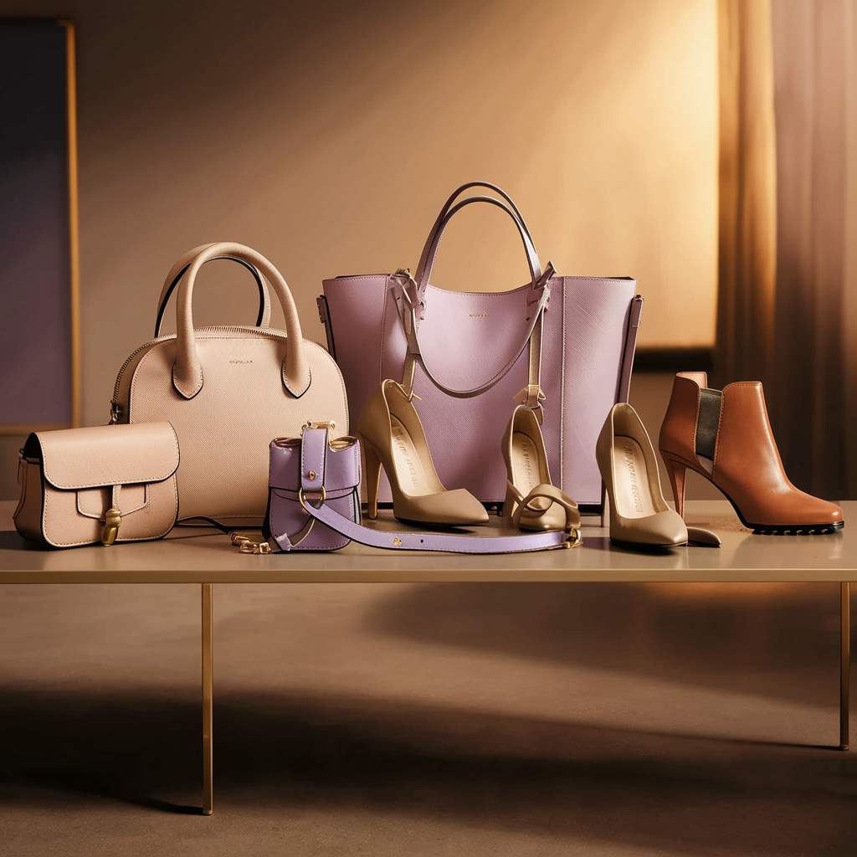
Introduction:
Lavender life exporting has a wide array of product catalogue which are categorized as under:
Fashionable Items
Small Leather Goods Items
Our products meet the style and color with perfection. Variety of styles for our clients, with authentic-look and taste as accepted in everyday-world.
Advancement of technology in regard to reaching your reliable Quality conscious associates for your business-irrespective to Buying & Selling, has made possible to identify the right Partner.
Lavender life exporting stresses on team-effort, determination and quality standards in achieving the highest trust with their partners. Thus constructing Global-Goodwill.
We are privileged to show-case our products in pictorial and textual patterns and may we take the opportunity to invite you - our partners to have a positive and relaxed set of mind to explore our capabilities, wherein we offer a bright future in the coming years

Slide 3
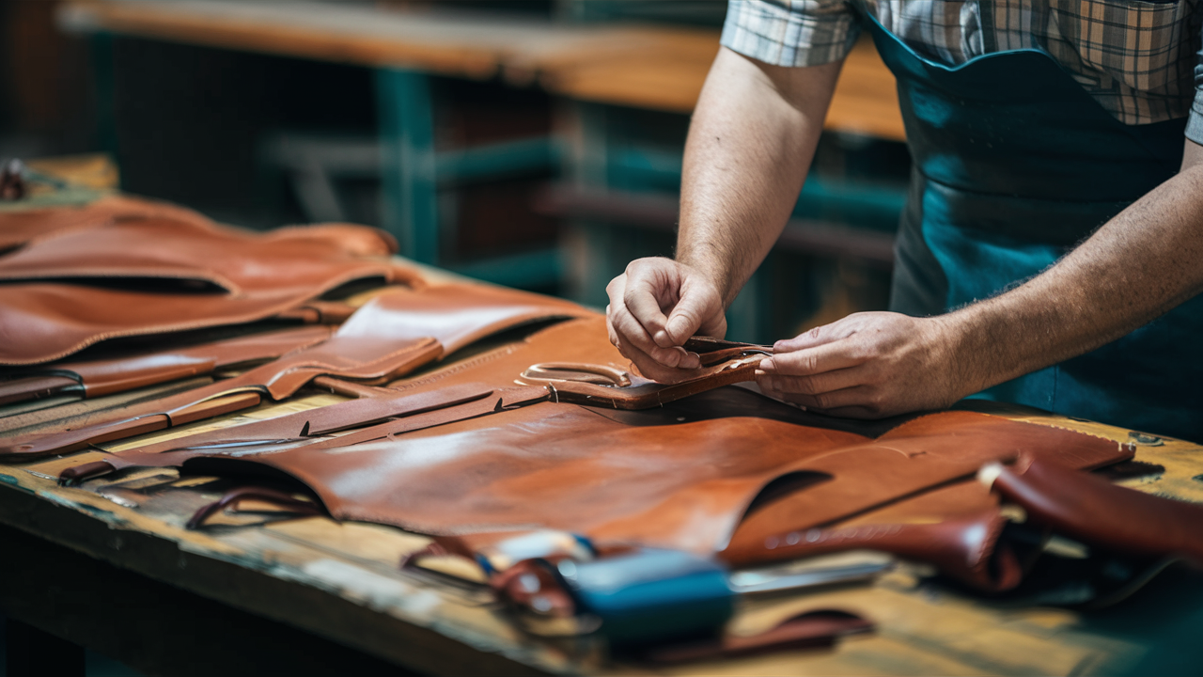
We, lavender life exporting Leather Goods , designer a manufacturer and exporter of a wide range of leather goods elegantly handcrafted out of handpicked leathers, in this field.
The Company have a diverse product range of bags, wallets, and small leather goods.
Who we are ?

Slide 4

Vision
We aspire to be a leader in the field of leather product manufacture
We attempt to match our clients' needs for branding in their designs.
We want to give our business partners a wide selection of leather products with attractive designs and prices.

Slide 5


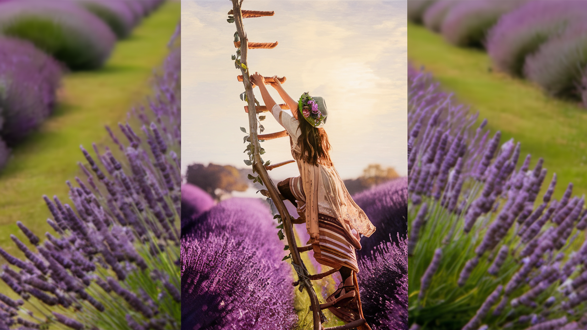
Future Projects
Addition of Space to increase the production capacity for all aspects.
Inclusion of Value Added Products
Fashionable Leather Accessories.

Slide 6
OUR VALUES
High-quality leather made mostly of calf, lamb, goat, and buffalo.
We might do sample development for free or at a very minimal cost.
Execution in smaller batches.
Always on task and focused on relationships.
We welcome any and all suggestions for improvement.
Assist you in selling.

Slide 7
Director
The Company was incorporated in the year of 2023 and started Exporting Leather
items since November 2023. We Are Exporting To The South African Countries
(Kenya, Ghana, Tanzania), Saudi Arabia, Germany And Turkiye

Slide 8
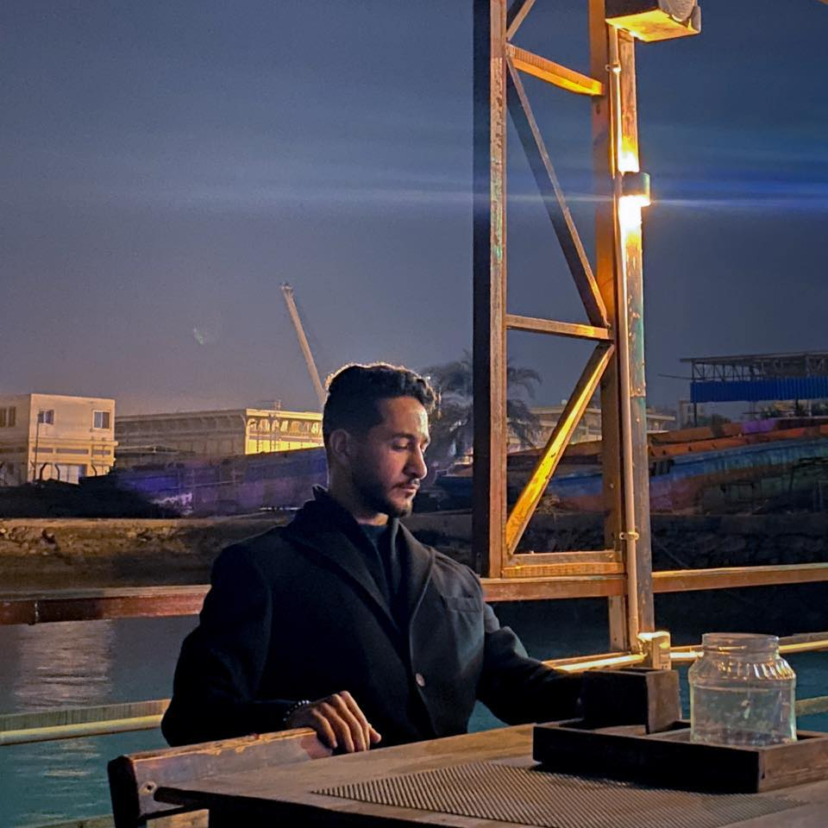
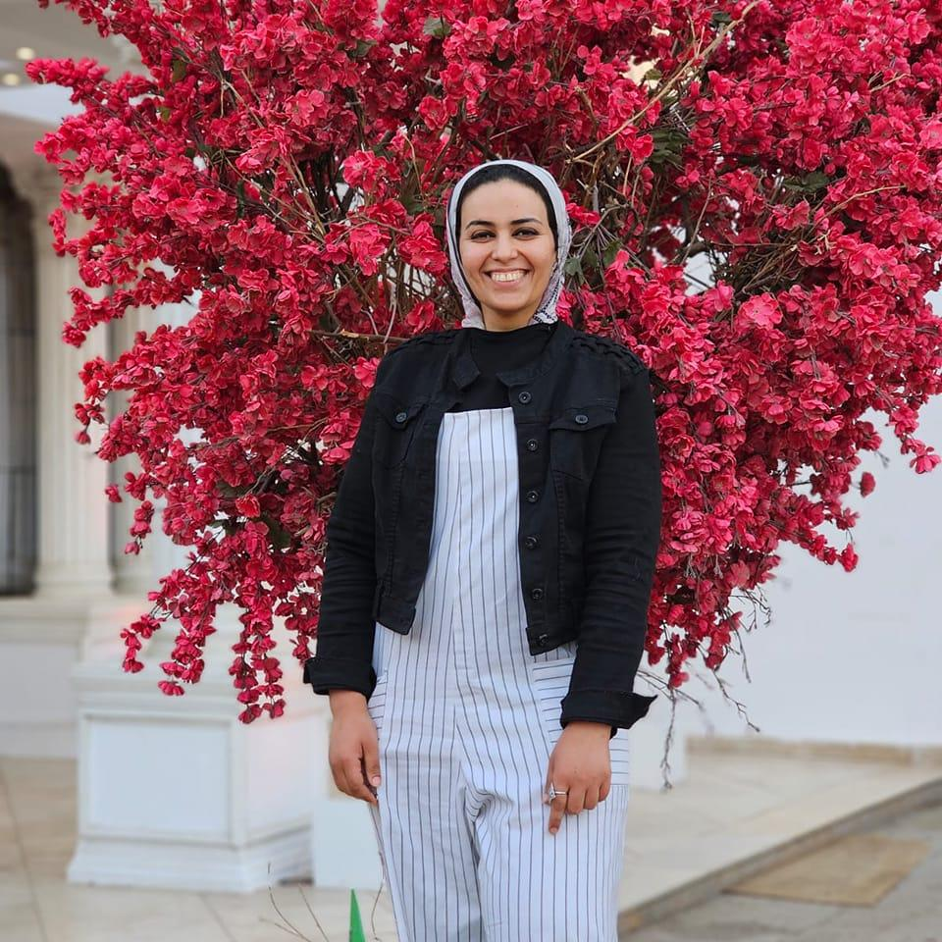
Chairman of the Board directors
DR.MOHAMED ABU EL FUTOH

Slide 9
Deputy Chairman of the Board
DR. MAI EL DARAWY
Master Degree in Exporting and International Trading .
She is a pharmacist who has a PH in clinical pharmacy from American collage of clinical pharmacy and she has a great experience in marketing and selling field, she was in love with the lavender flower she always used it to calm herself after a hard day , Dr Mai realized that the lavender has an effective role in calming the nerves system, she also start to calm her baby with lavender oil when he had a Umbilical hernia it was the only way to comfort the child ...she start learning about the different types of lavender and how The method of planting and growing it differs from one country to another , Dr Mai and dr. Mohamed decided to make a special design in which they can use Natural leather with natural lavender scent to make a special brand that can calm your mind..

Slide 10
Meet Our team
Mr.Ahmed kaoud
Accounting Manager
Mrs. Marin Ghazaly Deputy
Chief Executive officer
Mr.Sameh
Cheif Executive officer

Slide 11
Our products

Slide 12





Our partenters

Slide 13
Previous works

Slide 14




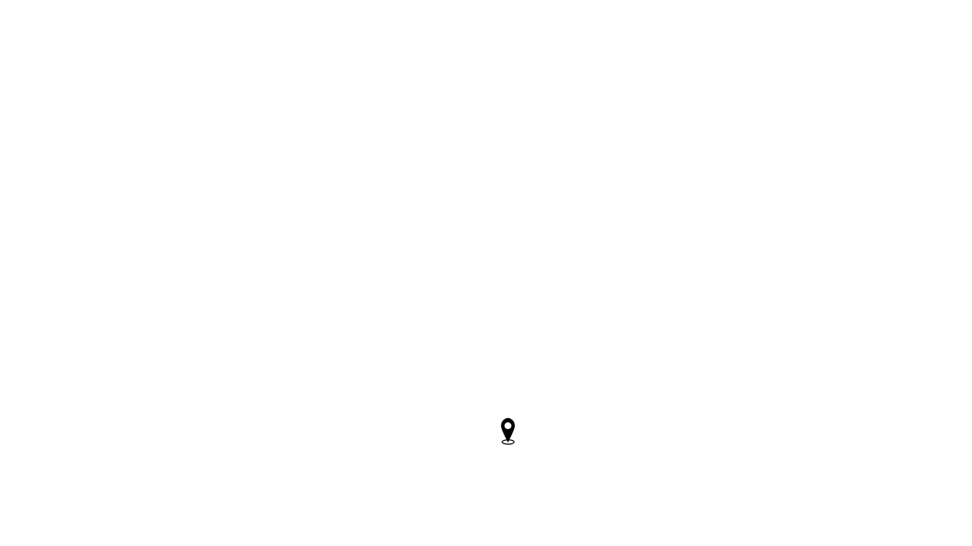



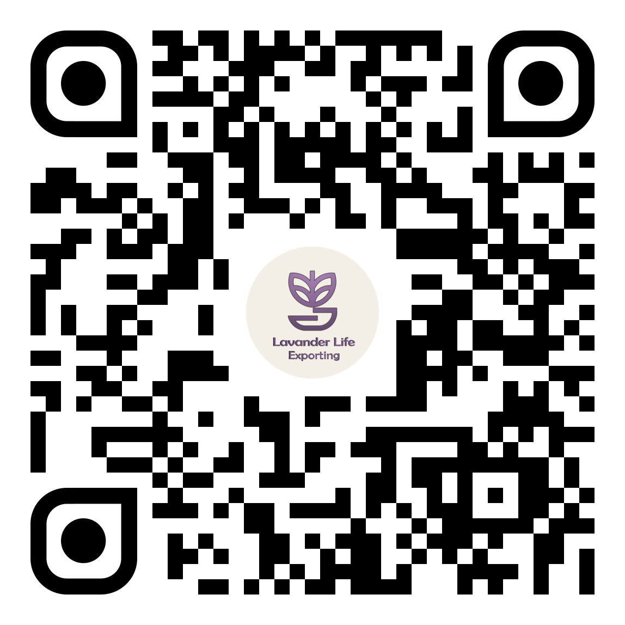
Pitch deck
Contact us :
+20 1011560541 – 1019831081
lavander.life.exp
Lavander life Exporting
Lavendermarketing634
Lavendermarketing634
Lavendermarketing634@gmail.com
Villa No. 3, adjacent to 8 - Third East District - Shorouk City 2 - Cairo Governorate
Thank you

